Slide 1
FINAL PROJECT PRESENTATION SYS660-Decision and Risk Analysis
Topic –Shoe Recommendation System
Prof Dr. Ting Liao
Group 7- WeiWei Tao, Priya Rao

Slide 2
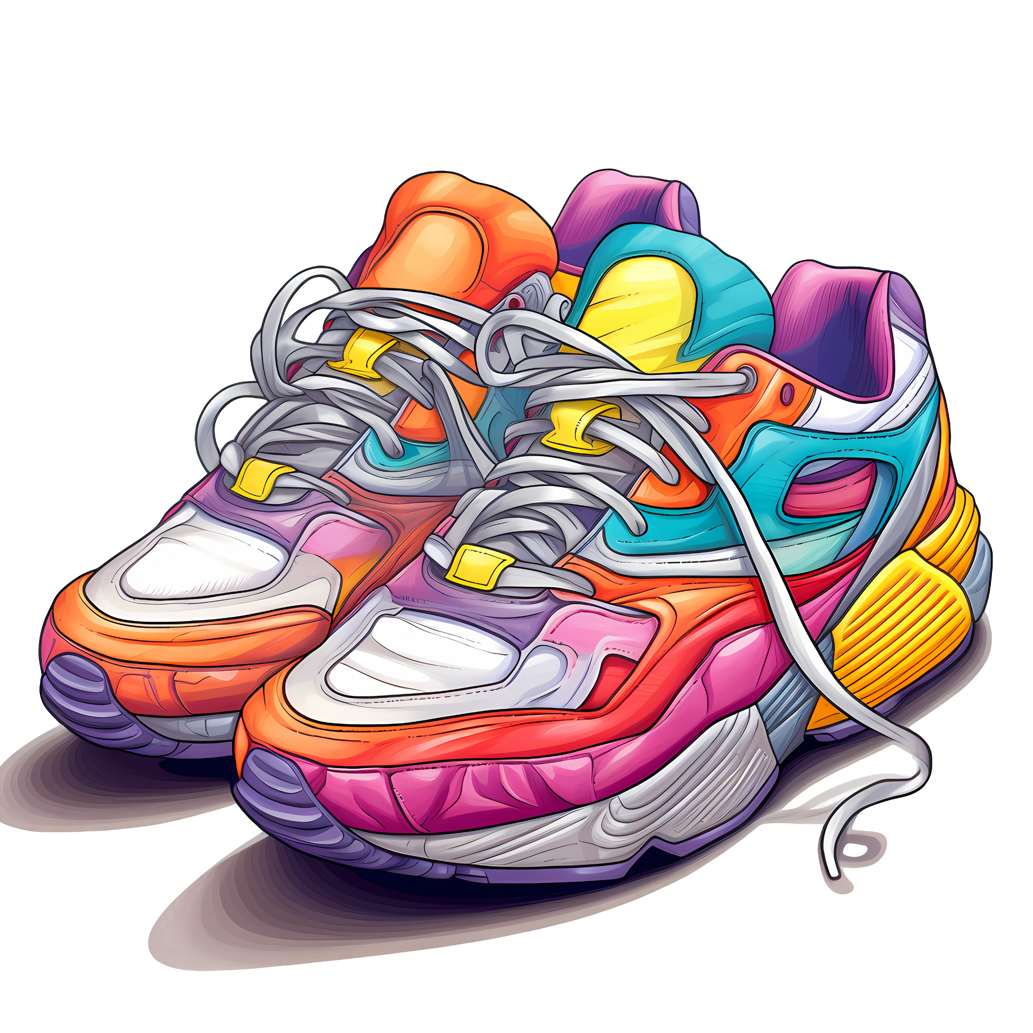
What is Shoe Recommendation System?
A shoe recommendation system is a software that provides shoe suggestions to customers based on price, gender, usage, ,material, feet length, customers, waterproof level, comfortability level. This particular kind of recommendation system is frequently employed by retail websites or e-commerce platforms that sell shoes.

Slide 3
Motivation
The convenience of online shopping and the growing need for individualized shopping experiences are the driving forces behind the development of a Decision Support System (DSS) for shoe suggestions. Finding the ideal pair of shoes that fits their needs in terms of comfort, style, and function can be difficult for consumers. This system's objective is to make the process of choosing shoes easier by using technology to provide personalized recommendations depending on each user’s needs.

Slide 4
Users of Shoe Recommendation System
The following people can make use of the Shoe Recommendation System:
Shoppers/Buyers: People who want to buy shoes online and are looking for advice and tailored suggestions based on their size, style, and other considerations.
E-commerce platforms and retail websites: By including a recommendation system into their websites, e-commerce sites and shops online hope to increase user engagement and happiness.
Manufacturers/Brands of Shoes: Companies that want to maximize their product offers and marketing strategies should be aware of consumer trends, tastes, and market demands. This includes shoe manufacturers and brands.

Slide 5
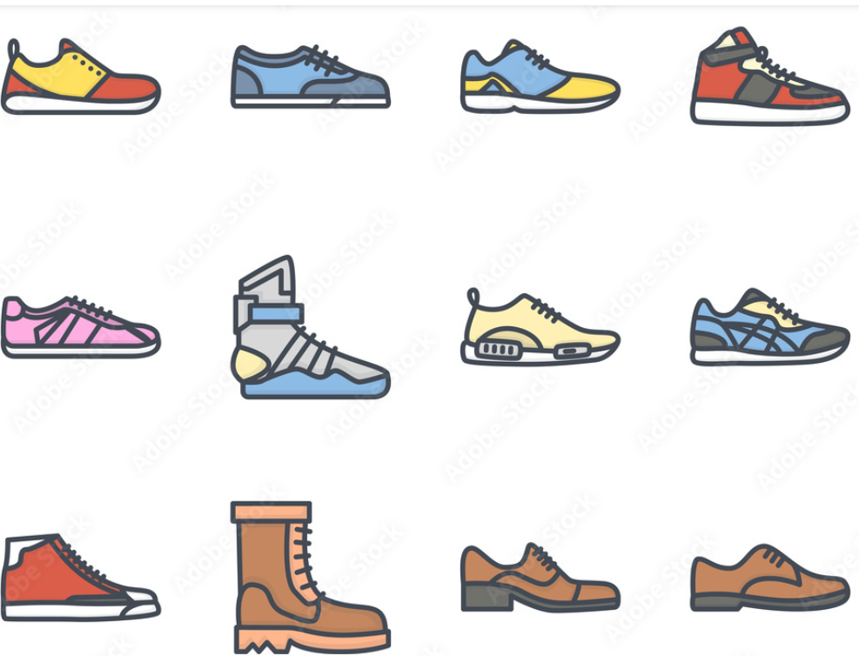
Types Of Shoes
Running shoes
Hiking shoes
Casual shoes
Walking shoes
Training shoes

Slide 6
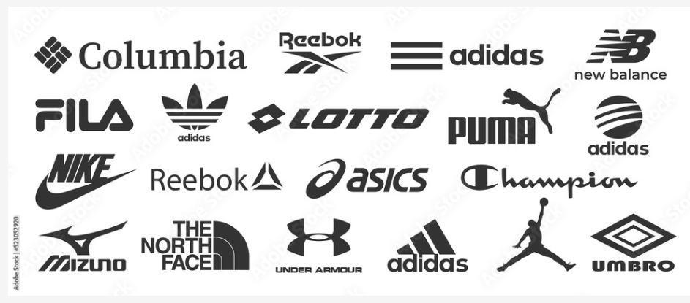
Brands of Shoes
Puma
Under Armour
New Balance
Adidas
Nike
Asics
Reebok
Skechers
Vans
Converse

Slide 7
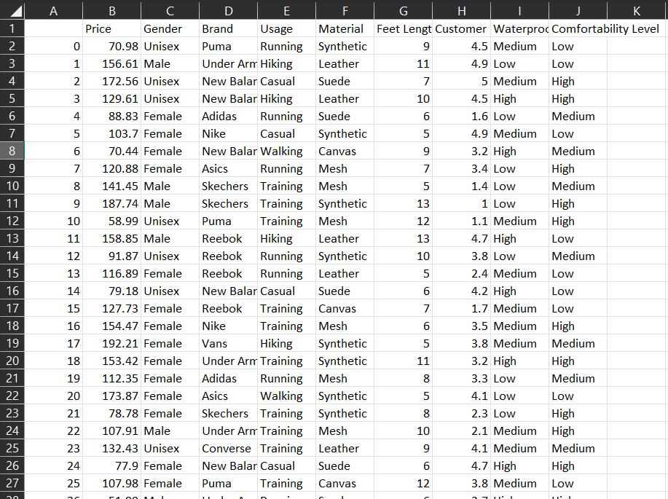
Data Collection

Slide 8
Dataset Description
Some of the attributes chosen from the dataset are price, gender, brand, usage, material, feet length, customer reviews, waterproof level, comfortability level.The dataset is described below:
Price -The cost of the shoes is represented by the price attribute.It might be a number that represents the price of the shoes, broken down into various price points or ranges.
Gender – The target gender of the shoes is indicated by this characteristic. It may consist of classifications like kids' shoes, women's shoes, or men's shoes, or it may be unisex, male, or female.
Brand - This characteristic speaks to the shoe's maker or brand. It might feature a variety of brands, like New Balance, Adidas, Puma, Reebok, and Nike.
Usage - This feature explains the intended function or purpose of the shoes. It may cover things like sports, hiking, work, casual and formal attire, running, etc.
Material - The main component that went into making the shoes is described in this feature. Materials such as suede, canvas, rubber, mesh, leather, and synthetics could be used.

Slide 9
Dataset Description Continued
Feet Length - The length of the foot that the shoes are appropriate for is represented by this characteristic. A number representing a shoe size or a measurement of the length of the foot could be displayed.
Customer Reviews - This attribute includes customer feedback or reviews about the shoes. It might contain text data, ratings (e.g., star ratings), sentiment analysis, or aggregated scores based on customer reviews.
Waterproof level - This feature indicates how water-resistant or waterproof the shoes are. It might have classifications like waterproof level to be low, medium and high.
Comfortability level - This feature shows how comfy the shoes are. The classification of shoes into high, medium, and low comfort levels may be based on consumer feedback, product specifications, or specific comfort-related qualities.

Slide 10
Selection Criteria
Price
Gender(include unisex products in both categories)
Brand
Usage
Material
Feet Length / Size
Customer Review
Quality of shoes(waterproof level, comfortability level)

Slide 11
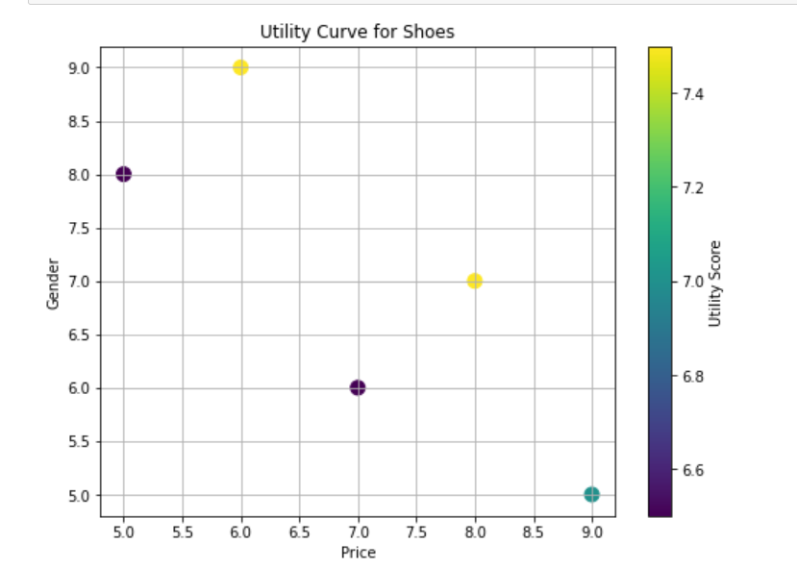
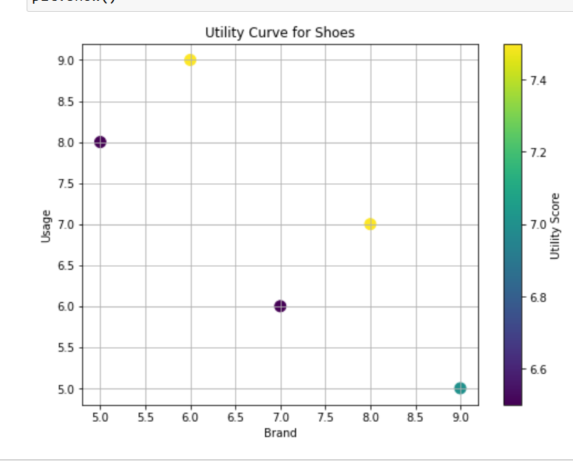
Utility Curves

Slide 12
Development Plan
Obtaining and Analyzing Data: Through collaborations with shops or direct data collection, amass a vast amount of information about shoes, including style, material, size, customer reviews, and preferences.
Algorithm Creation: Create and implement recommendation algorithms that assess user preferences and make precise recommendations by leveraging collaborative filtering or machine learning approaches.
Designing User Interfaces: Provide a simple, easy-to-use interface (web or app-based) that allows users to explore recommendations, enter their preferences, and leave comments.
Customization Elements: Incorporate features that let users customize their experience, like shoe type, color, size, occasion, and compatibility with user-specific needs (like orthopaedic requirements).
Testing and Integration: To guarantee accuracy, relevance, and user happiness, integrate the recommendation system with e-commerce platforms and carry out thorough testing.
Launch and Monitoring: Make the system available to consumers, keep an eye on its functionality, get input, and make ongoing adjustments based on how users interact with it and their preferences.
This plan highlights the need of taking a user-centric approach, with the goal of developing a strong recommendation system that makes choosing shoes easier for customers and provides manufacturers and retailers with insightful data to improve their products and business plans.

Slide 13
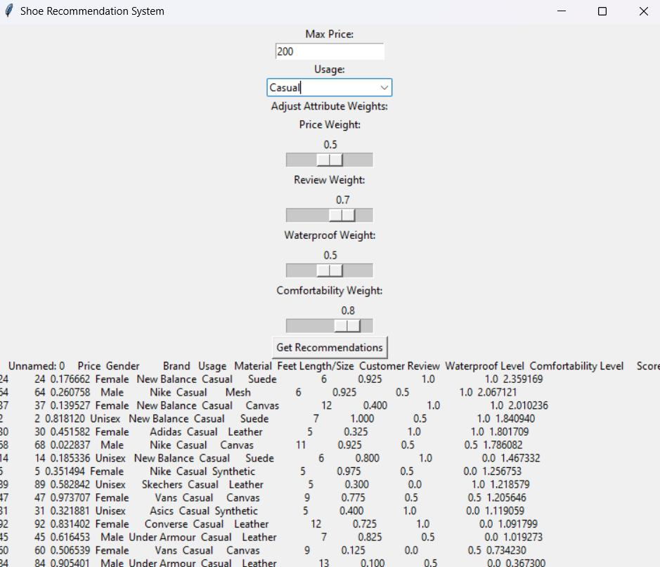
User Input

Slide 14
User Input Description of Shoe Recommendation system
The above screenshot represents an interface of the shoe recommendation system.
Two inputs- Max Price and Usage. Usage dropdown has 4 options casual,hiking,running and walking. Four attribute weights-Price weights, Review weights, Waterproof weights and Comfortability weights.
Enter Max price as $200, and Usage as casual from dropdown.Next set attribute weights, adjust price weights to 0.5, review weights to 0.7, waterproof weights to 0.5 and comfortability weights to 0.8.
Click the get recommendations option
A series of shoe recommendations would be displayed

